Slide 1
Unit Testing

Slide 2
Lesson goals
What is code testing
Why we need it
How to write tests
Tests and Mocking
Code coverage
Testing methodologies

Slide 3
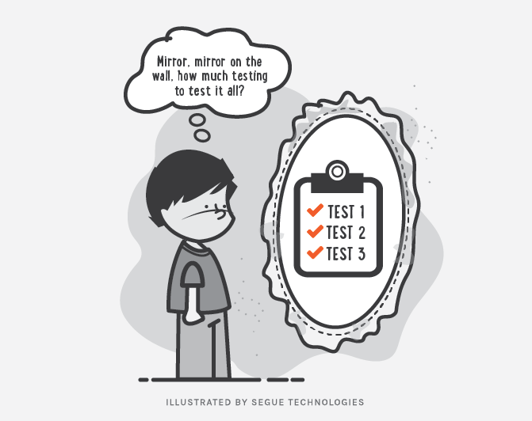
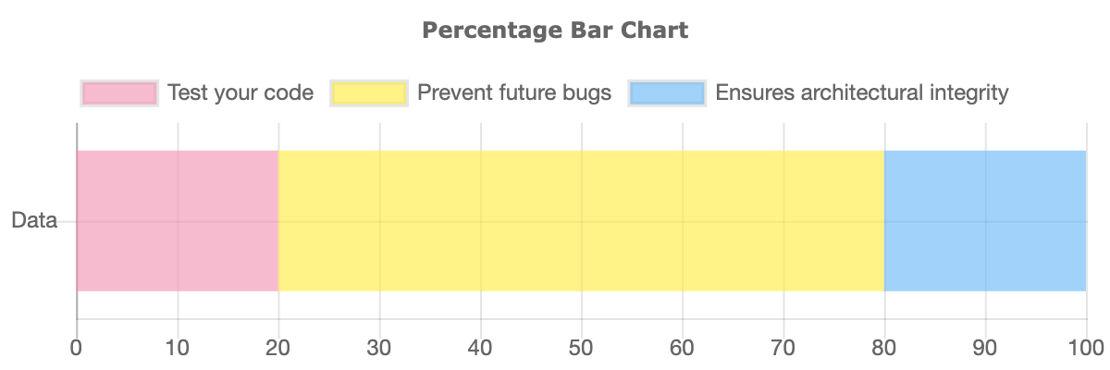
Code Testing

Slide 4
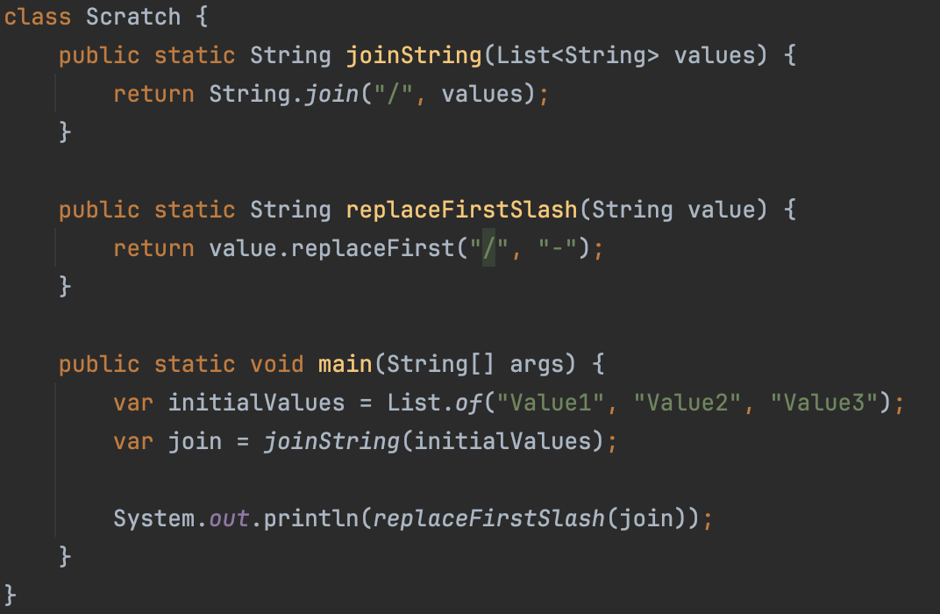
Importance
Scenario : “Let’s make a small fix!!!” (replace “/” to “;”)

Slide 5
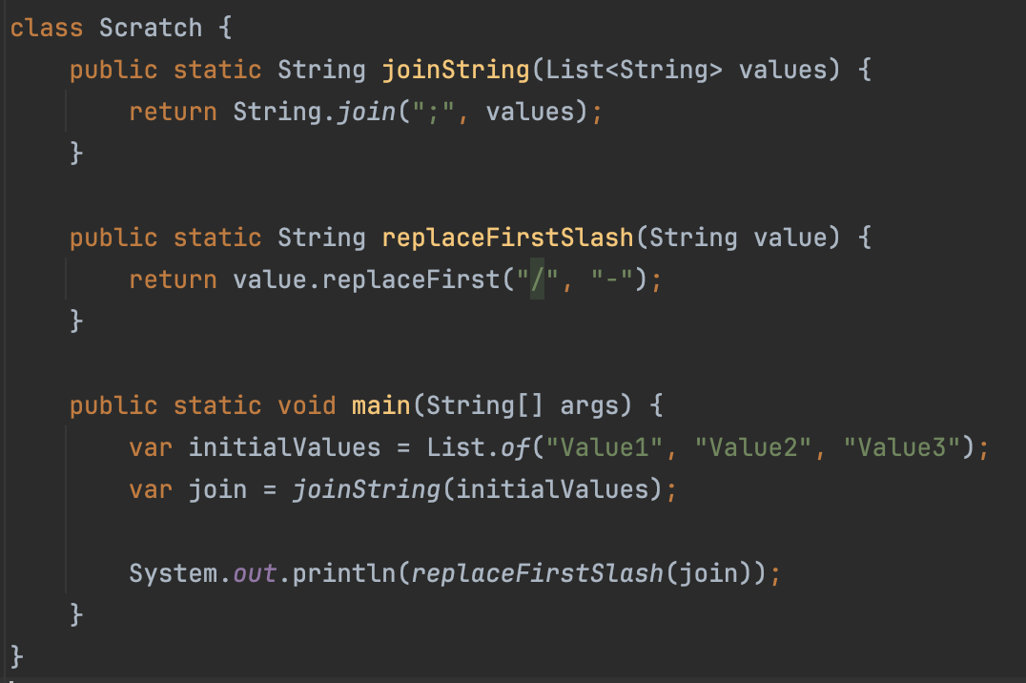
Importance
Scenario : “Let’s make a small fix!!!”
Action: Developer changes a “simple” line of code.

Slide 6
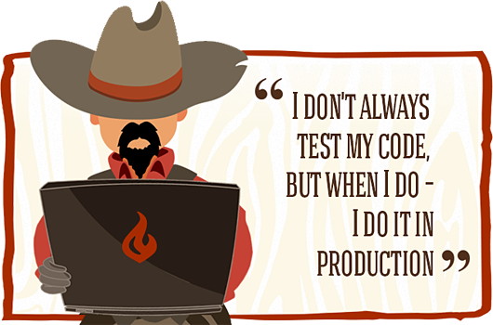
Importance
Scenario : “Let’s make a small fix!!!”
Action: Developer changes a “simple” line of code.
Result: This quick fix solve the problem but broke other parts of the program 😈

Slide 7

Testing levels aka “Testing Pyramid”
Manual Testing
$$$$
$

Slide 8
Pros vs Cons
Bugs preventing
Easy refactoring
Better code architecture
Documentation
Less debugging cases
Time saver
Money saver
Must have practice for big projects
Guarantee that your code is working as expected

Slide 9
Pros vs Cons
Bugs preventing
Easy refactoring
Better code architecture
Documentation
Less debugging cases
Time saver
Money saver
Must have practice for big projects
Guarantee that your code is working as expected
Needs more time for first coding
Require support
Possible overhead
Hard to write good tests
Hard to apply on legacy code

Slide 10




Testing libraries

Slide 11
Unit testing

Slide 12

Unit Test Example
class Calculator {
int add(int x, int y) {
return x + y;
}
}
import org.testng.annotations.Test;
import static org.testng.Assert.*;
public class CalculatorTest {
@Test
public void adding_two_numbers() {
Calculator calculator = new Calculator();
int actualResult = calculator.add(1, 2);
int expectedResult = 3;
assertEquals(actualResult,expectedResult);
}
}

Slide 13
How to setup & run tests
Setup:
Add test library to project
Run:
Directly from IDE (mostly used)
Via build system (Gradle task verification::test)
CI server to assure that nothing was broken

Slide 14

Working with IDE

Slide 15
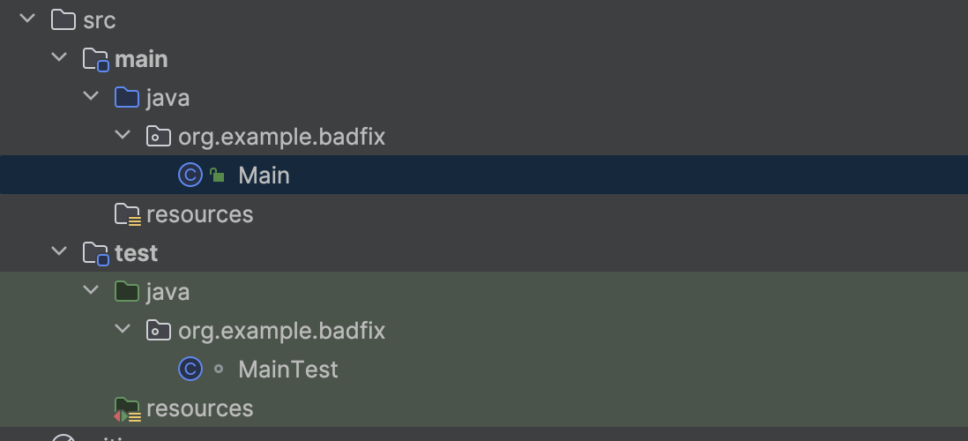
Test Source code convention

Slide 16
Code Convention in Tests
Test of class should be in same package in test source root
Tested class should have same name as tested class with suffix “Test”
One convention for all tests

Slide 17
Tested method names patterns
calculate_when2NegativeValue_shouldReturnPositiveValue
calculate_when2Positivevalue_shouldReturnPositiveValue
calculate_when1NegativeAnd1PositiveValue_shouldReturnNegativeValue

Slide 18
Test results verification
assertEquals(Object o1, Object o2)
assertNotEquals(Object o1, Object o2)
assertTrue(boolean condition)
assertFalse(boolean condition)
assertNull(Object o)
assertNotNull(Object o)
more in org.testng.Assert.*

Slide 19
Test results verification (AssertJ)
assertThat(actual).isEqualTo(expected);
assertThat(list).hasSize(3).contains("apple", "orange", "banana");
assertThat("hello").startsWith("he").endsWith("lo").contains("ell");
assertThat(42).isGreaterThan(0).isLessThanOrEqualTo(100);

Slide 20
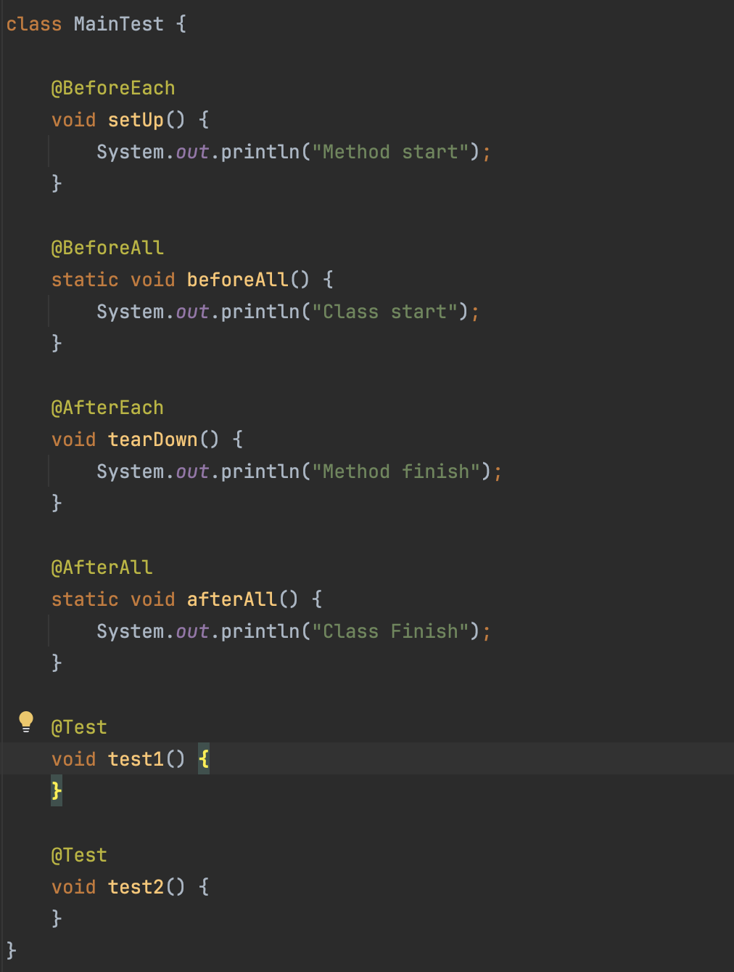
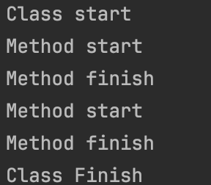
Test configurations

Slide 21
Which code should be tested by Unit tests?
Yes
Business logic
Everything that contain conditions
No
Working with file system or DB
Working with some external services or internet

Slide 22
What you should not test
Other frameworks or libraries
Trivial code like “get/set”
Code that has non deterministic results (Think random numbers)

Slide 23
What is a good Unit test
Easy to understand
Easy to run
Repeatable
Has one logical assertion
Independent(Isolated)
Incremental
Test single unit
Maintainable
Fast
Informative (in case of fail)

Slide 24
Good practices
Limit bounds test cases (especial for user input)
Reset components before each test
Test success cases and fail cases separately
Dependency injection through constructor

Slide 25
Mocking

Slide 26
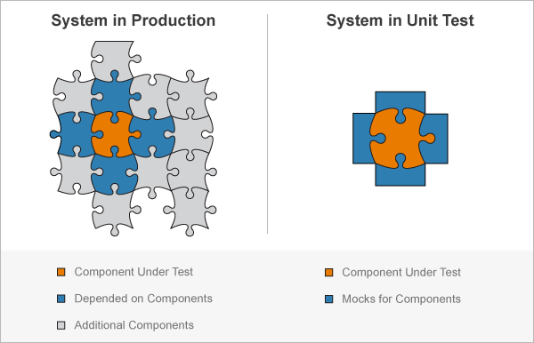
Mock Concept

Slide 27
Mock Types
Stub – do nothing
Mock – perform mocked operations
Spy – real object with mocked operations

Slide 28


Mocking libraries…

Slide 29
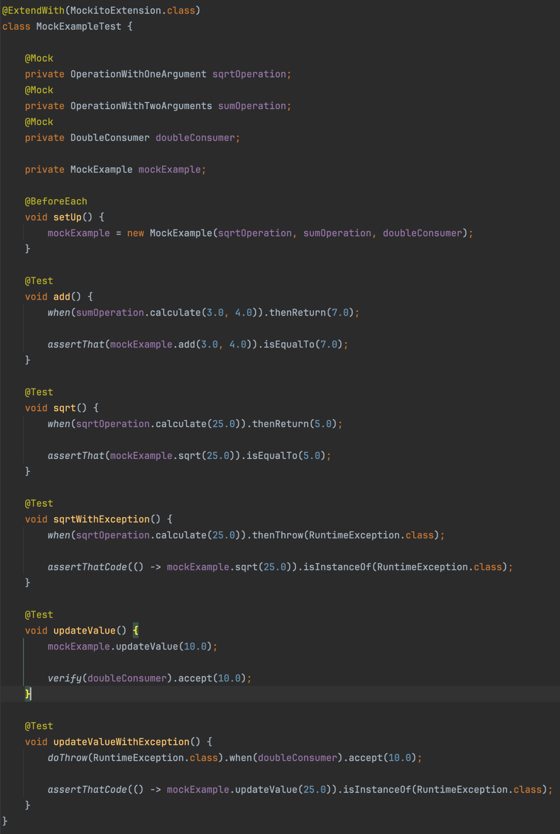
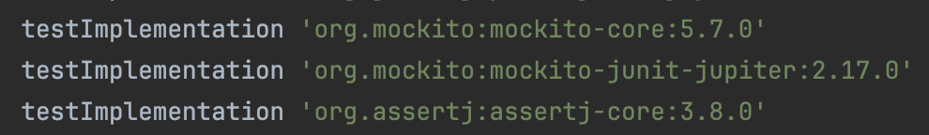
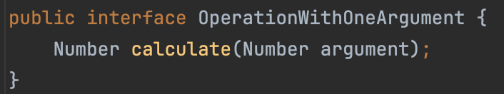
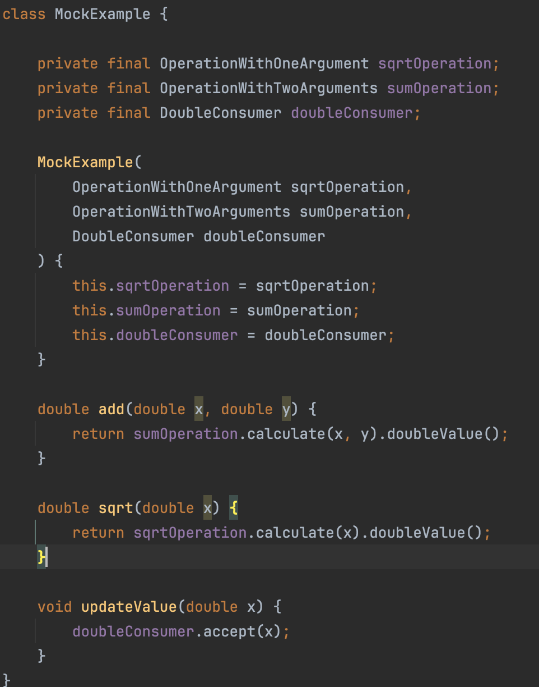
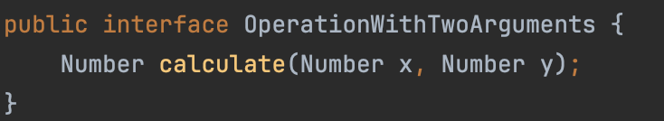
What is Mock ?

Slide 30
Argument matchers
any()
anyInt/String/etc()
any(Class c)
anyCollection/List/Set/Map()
eq()
More in class “org.mockito.ArgumentMatchers‘

Slide 31
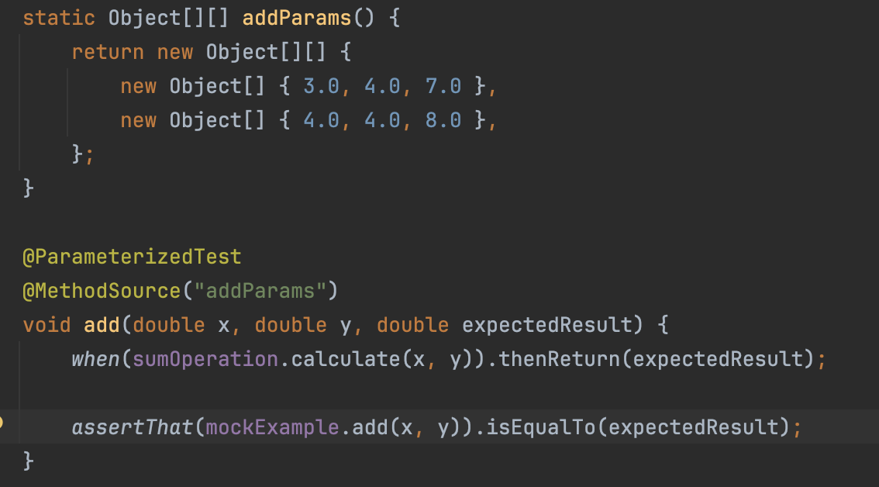
Parametrized Test

Slide 32

Code Coverage

Slide 33
Test Driven Development

Slide 34
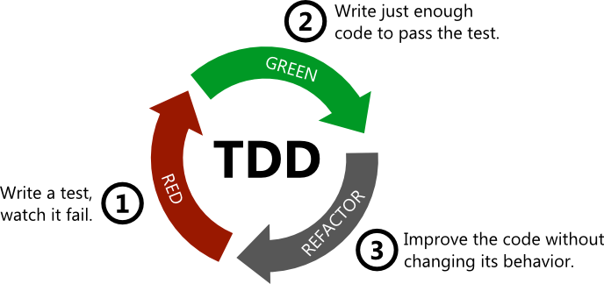
Test Driven Development

Slide 35



HOMEWORK
Java Application for Fetching Random Facts about Cats
Create a Java application that fetches random facts about cats from the Cat Fact API (https://catfact.ninja/fact) and writes them to a file at regular intervals. The application should be configurable with the time interval and the file path, either through system environment variables or command-line arguments.
Requirements:
- Use the Apache HTTP client to make requests to the Cat Fact API and retrieve random facts about cats.
- The application should retrieve the time interval for fetching facts from the system environment or command-line arguments.
- Facts should be written to a file every specified time interval. The file path should also be configurable from the system environment or command-line arguments.
- Implement a retry mechanism to fetch new facts if the API response is unsuccessful or duplicated (already exists in file). Allow up to 5 retries before writing "I don't know any new facts" to the file.
- Achieve 100% code coverage.
- Optionally, provide support for JaCoCo to generate code coverage reports for the application.

Slide 36

Thanks!
Any Questions?
Or find us in Slack:
@Yaroslav Brahinets
@Vasya Rudas

